Slide 1

Car Rental Company
Group 29:
Ashok Thiruvengadam
Shangling Wang

Slide 2
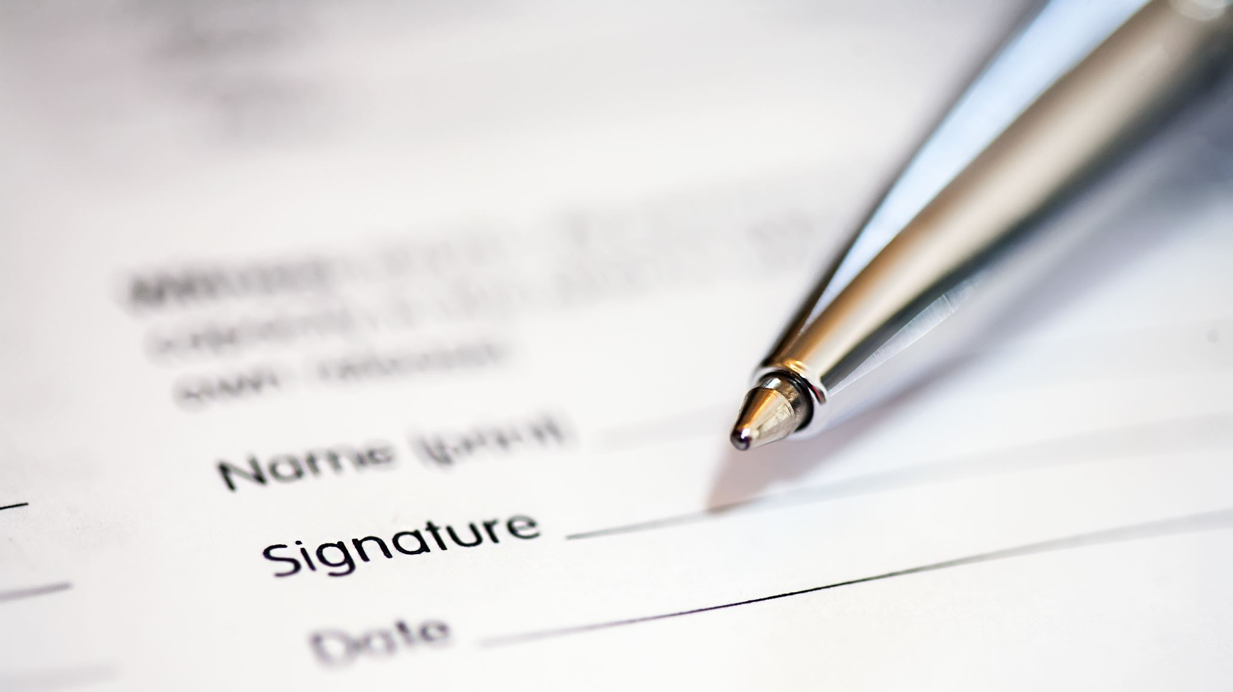
Business Problem

Slide 3
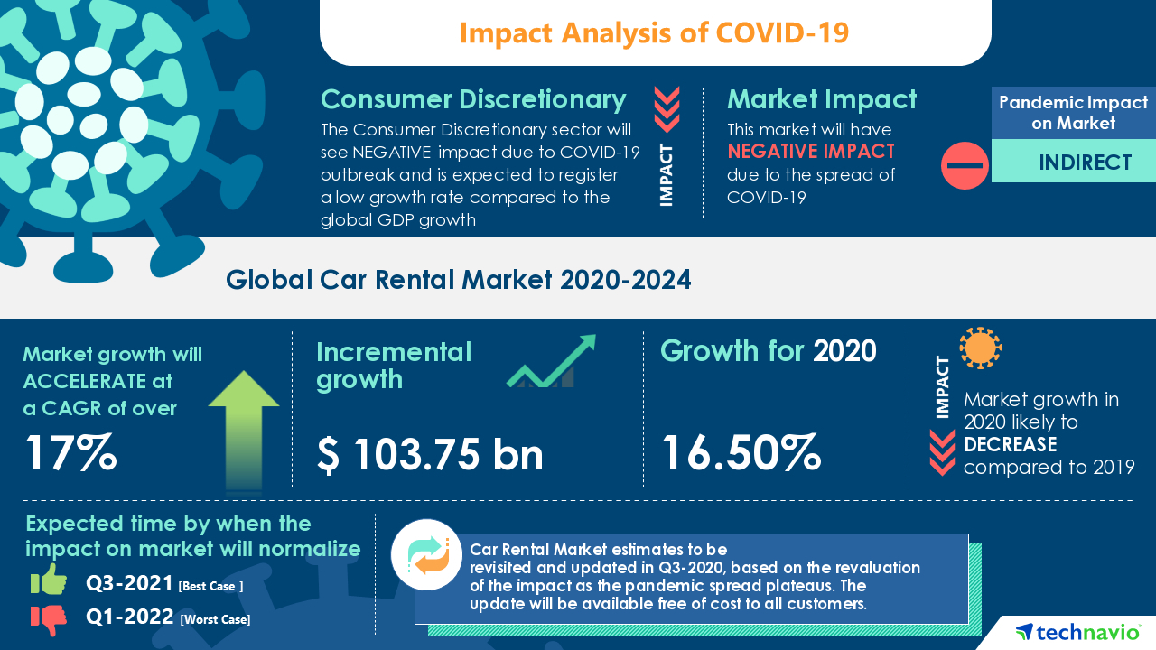
Background: The pandemic situation is getting better and , and people are eager to travel
Goal: Building a database to help rental companies get back on track

Slide 4

Requirements

Slide 5
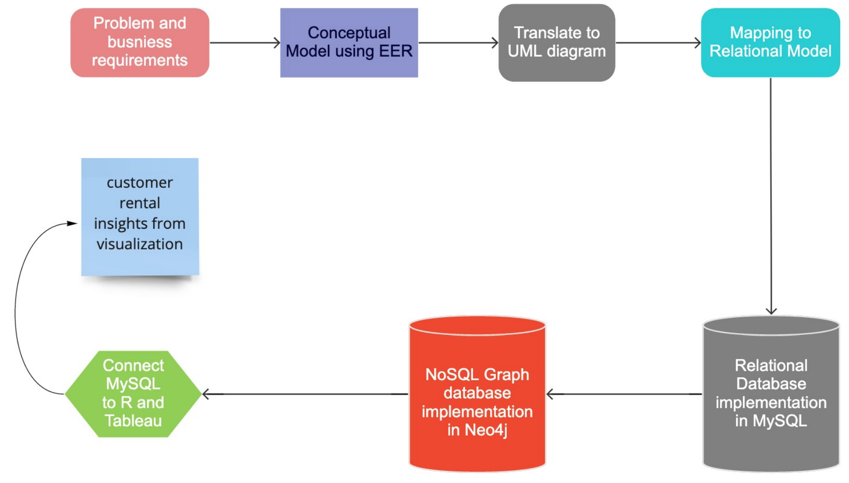
Flow Chart

Slide 6
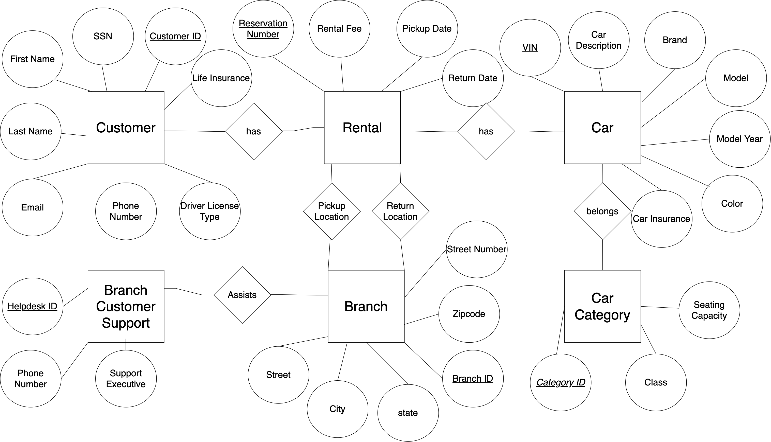

Conceptual Data Modeling - EER Model

Slide 7
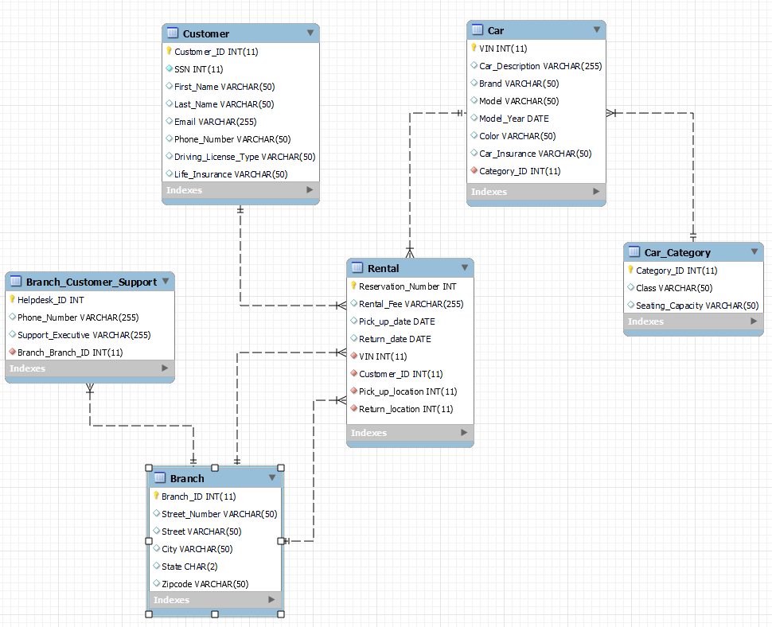
Conceptual Data Modeling - UML Model

Slide 8
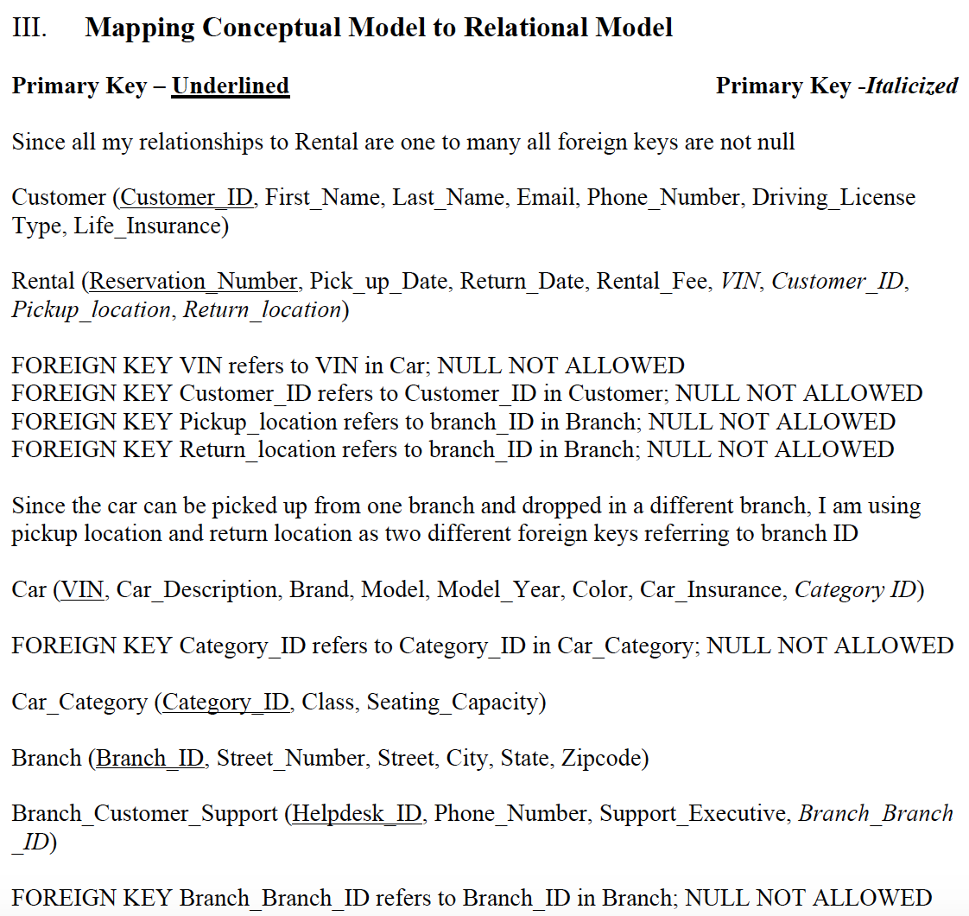

Mapping Conceptual Model - Relational Model

Slide 9

Implementation of Relation Model - MySQL

Slide 10

MySQL query

Slide 11

Implementation of NoSQL database using Neo4J

Slide 12
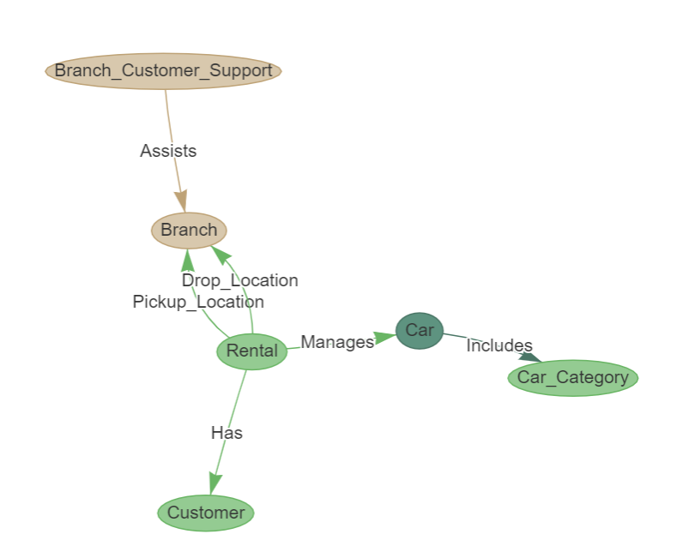
Graph Database

Slide 13

Database Access –R

Slide 14
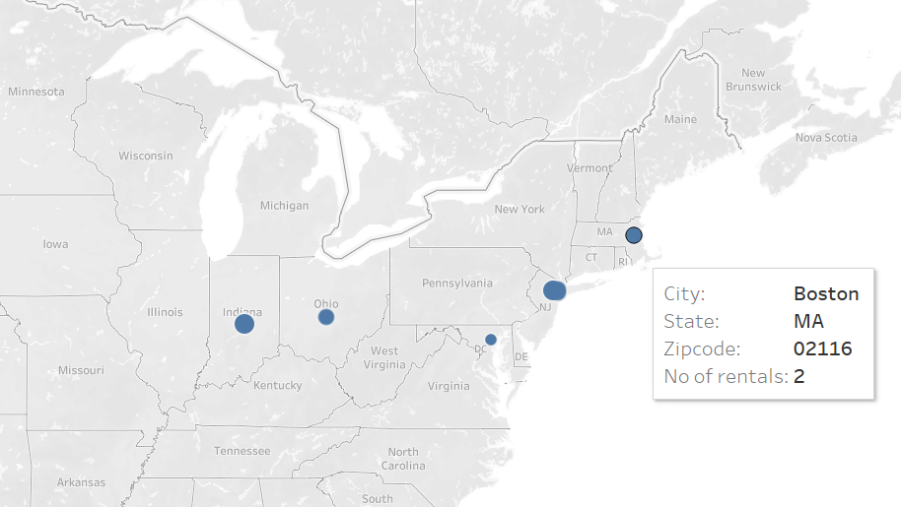
Visualization using Tableau

Slide 15

Summary

Slide 16

Recommendation
We should find more observations in order to implement on NoSQL
implementing Machine Learning models to quote dynamic pricing

Slide 17

Thank you

